Slide 1

Learning
Chapter 6

Slide 2
Reminders!
Exam 2 (10/4) (1 week from today!)
  Chapters 5 & 6 (Consciousness & Learning)
Quiz 5 (now open – due SUNDAY 10/2 @ 11:59pm

Slide 3

Learning Theory (1)
Learning:
  Permanent (or relatively permanent) change in behavior as a result of experience
  Many forms:
    Skill Acquisition
    General knowledge (memorization)
    Social learning (rules, norms, etc.)

Slide 4
Learning Theory (2)
Behaviorism
  A learning theory that focuses exclusively on observable behaviors
    Mental processes do not matter
    “Conditioning” and “Conditioned”
      Behaviorist term for the process of learning or when a task is learned

Slide 5
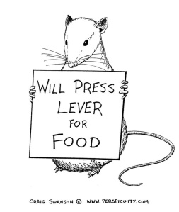
Learning Theory (3)
Associative Learning
  Learning that occurs when two events are paired together
    Presence of event X typically
    results in outcome Y

Slide 6

Learning Theory (4)
Observational Learning
  Learning through watching and imitation

Slide 7
Learning Theory (5)
Common in children!
  Usually starts in infancy (~8 months old)
    Example: Gestures, facial expressions, etc.
  18 months: Imitate more complex behaviors
    Example: Imitate chores, tool use, etc.
  36 Months: Imitate multi-step actions from memory (routines)
    Example: pretend play

Slide 8
Learning Theory (6)
Imitation in Older Children and Adults:
  How do others act in certain social situations?
  Common to imitate behaviors of individuals we admire
  Can be subconscious or deliberate
    Social imitation: geared towards achieving a social goal (Example: friendship)

Slide 9
Classical Conditioning
Learning of REFLEXIVE/INVOLUNTARY behaviors to a new stimulus
  Reflexive = Fear, Hunger, Thirst, etc.
  The presentation of a learned stimulus produces a reflexive response
Type of associative learning
  Pairing of two stimuli lead to a reflexive response

Slide 10




Classical Conditioning
  Example: Little Albert
SEES
Loud noise
=
Fear
→
=
Fear

Slide 11
Classical Conditioning
Unconditioned Stimulus (US)
  The new stimulus that does not produce a response
Unconditioned Response (UR)
  Reflexive Behavior (Fear, Hunger, etc.)
When paired together the US can elicit a UR
  The US becomes the Conditioned Stimulus (CS)
  The UR becomes the Conditioned Response (CR)

Slide 12
Classical Conditioning
  Example: Little Albert
Unconditioned
Stimulus
SEES
Unconditioned
Response
Loud noise
=
Fear
→
Conditioned
Stimulus
=
Conditioned
Response
Fear

Slide 13
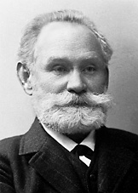
Ivan Pavlov
Russian Physiologist
  Studied digestion
When entering the lab each morning, dogs started salivating
  Why?
  Footsteps of the individual signaled that food was coming

Slide 14
Ivan Pavlov – Classical Conditioning
Acquisition Phase
Repeatedly Paired Together
Food
(Involuntary Stimulus;
CS)
Always Produces Response
Footsteps
(US)
Salivation
(UR)

Slide 15
Ivan Pavlov – Classical Conditioning
Food
(Involuntary Stimulus;
CS)
Footsteps
(CS)
Salivation
(CR)
Always Produces Response

Slide 16
Keys for Acquisition
Contiguity
  Must appear close together in time
Contingency
  The US must predict the CS
Good contiguity and contingency mean stronger and more rapid acquisition

Slide 17
Generalization vs. Discrimination
Generalization
  Similar US can show similar effects as a CS
  E.g., Pavlov, a Bell (CS) produced salivation (CR), and this effect generalized to a similarly sounding whistle
Discrimination
  Specification that only the CS elicits the CR, not another US that is similar to the CS

Slide 18
Little Albert Experiment (1920) –
Watson & Rayner
Conditioning of a fear response (UR) to a harmless stimulus (US)
  AKA, phobic response
  Video
  https://www.youtube.com/watch?v=FMnhyGozLyE

Slide 19
What ever happened to Little Albert?
Mother paid $1 for participation
No follow up studies were conducted with Baby Albert…
  Never de-conditioned
  Did phobia of soft objects persist?
Death Records: Douglas Merritte
  Died in 1926 of hydrocephalus

Slide 20
What ever happened to Little Albert?
Outcome is unclear:
Death Records: Douglas Merritte
  Died in 1926 of hydrocephalus (build up of excess fluid in brain)
Albert Barger, lived a healthy life (died in 2007)
  Aversion to dogs

Slide 21
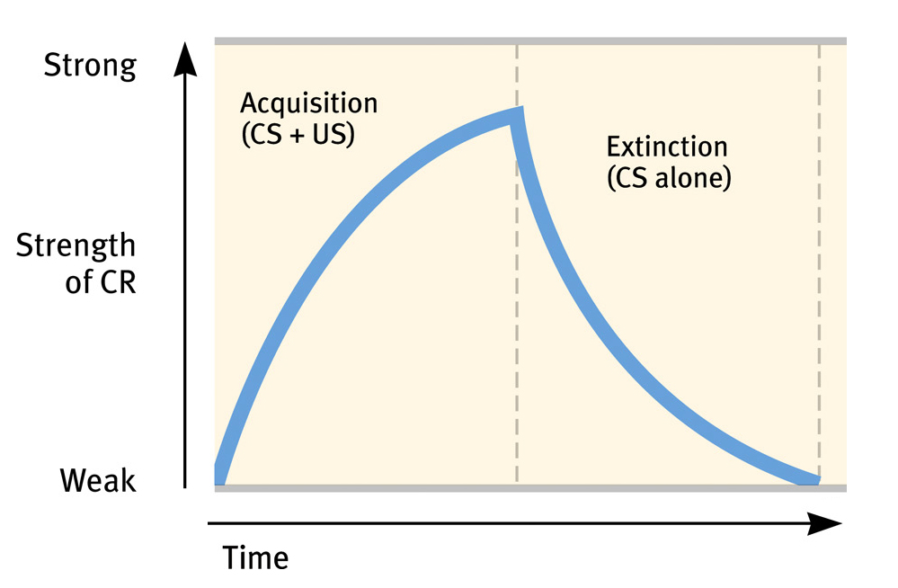
Extinction
When the bell (CS) is not followed by food (US), salivation (CR) begins to decrease

Slide 22
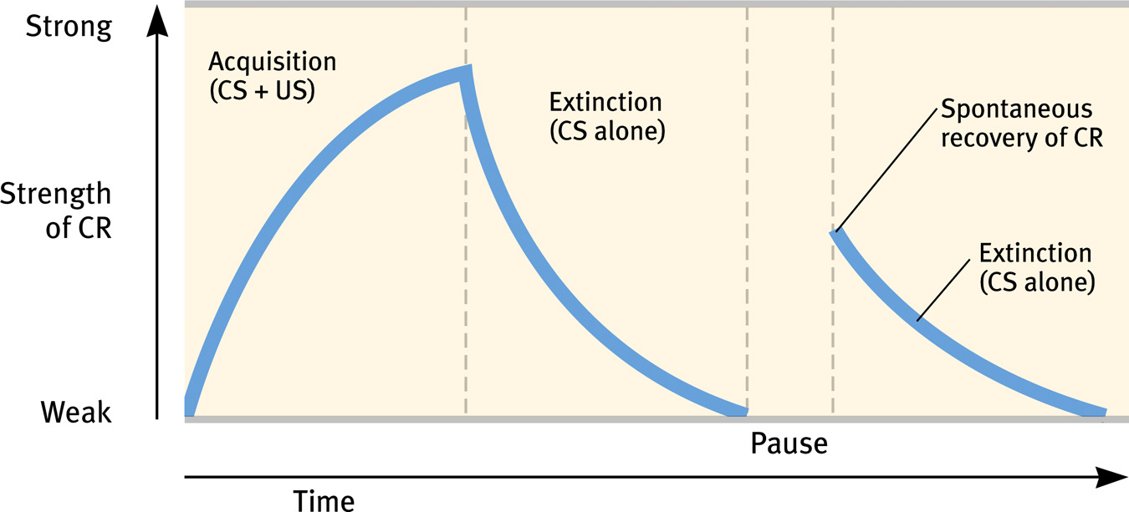
Spontaneous Recovery/Renewal
The resurgence of an extinct behavior
  Difficult to control/predict
Renewal: Occurs when subject is placed in a novel context

Slide 23
Classical Conditioning in Everyday Life
Habits/Addictions
  Habituation – requires an increase in CS to get original CR
Responses from the body’s internal organs
  Antibiotic effects can be increased if consumption is paired with a US
  Can also result in immunosuppression
Taste aversion

Slide 24
Reducing CS-CR Pairings
Counterconditioning
  Changing the relationship between CS-CR
    Pairing the CS with a different CR
    Pairing the CR with a different US
Aversive Conditioning
  Pairing the CS with something very unpleasant
    Alcoholics and Antabuse

Slide 25
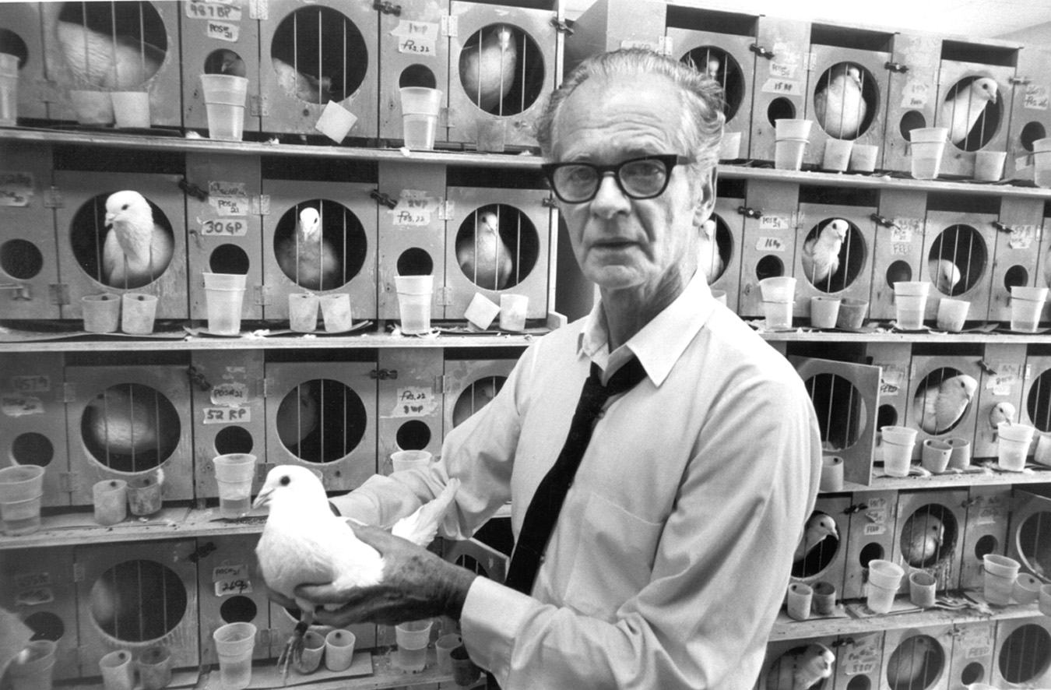
Operant Conditioning
Learning that occurs through consequences
B.F. Skinner
  Reinforcements and Punishments
  Same effect across all species
E.L. Thorndike: Behaviors that are followed by good outcomes will increase; negative outcomes will decrease
  “Law of Effect”

Slide 26
Operant Conditioning
Skinner: Learning does not occur through mental processes, only through reinforcement and punishment
“Pure Behaviorist”
  Only observable behaviors and observable consequences matter

Slide 27


Reinforcement
A type of consequence that increases the probability that the preceding behavior will occur in the future
Positive Reinforcement
  The addition of a
  desirable stimulus
  Reward
Negative Reinforcement
  The removal of an
  undesirable stimulus

Slide 28
Types of Positive Reinforcers
Primary Reinforcer
  Requires no “learning” to be reinforcing
  E.g., food, sex, thirst, etc.
Secondary Reinforcer
  Becomes reinforcing through association with a primary reinforcer
  E.g., money, academic grades, compliments, etc.
Clicker Training – Secondary Reinforcer
https://www.youtube.com/watch?v=IC367wKGi4M

Slide 29
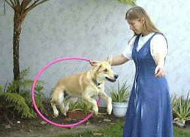
Shaping
How can one train a dog to jump through a hoop?
  The reinforcement of close approximations to a desired behavior

Slide 30
Reinforcement Timing/Schedules
Timing of the reinforcer is key
  Subject must link reinforcement to behavior
Reinforcement schedules can maximize desired behaviors
Continuous Reinforcement
Intermittent Reinforcement
  Fixed Ratio – Reinforcement occurs after a set number of correct behaviors
  Variable Ratio – Reinforcement occurs after a variable amount of correct behaviors
  Fixed Interval – Reinforcement occurs after a fixed amount of time after a correct behavior occurs
  Variable Interval – Reinforcement occurs after a variable amount of time after a correct behavior occurs

Slide 31
Schedules of Reinforcement (1)
Intermittent Reinforcement: Ratio Schedules
  Based on the number of correct behaviors that occur
  Fixed Ratio – Reinforcement occurs after a set number of correct behaviors
    Examples: Sales commissions, tokens
  Variable Ratio – Reinforcement occurs after a variable amount of correct behaviors
    Examples: Gambling

Slide 32
Schedules of Reinforcement (2)
Intermittent Reinforcement: Interval Schedules
  Based on the amount of time that passes
  Fixed Interval – Reinforcement occurs after a fixed amount of time after a correct behavior occurs
    Example: A weekly paycheck
  Variable Interval – Reinforcement occurs after a variable amount of time after a correct behavior occurs
    Example: Boss randomly checking on you.

Slide 33
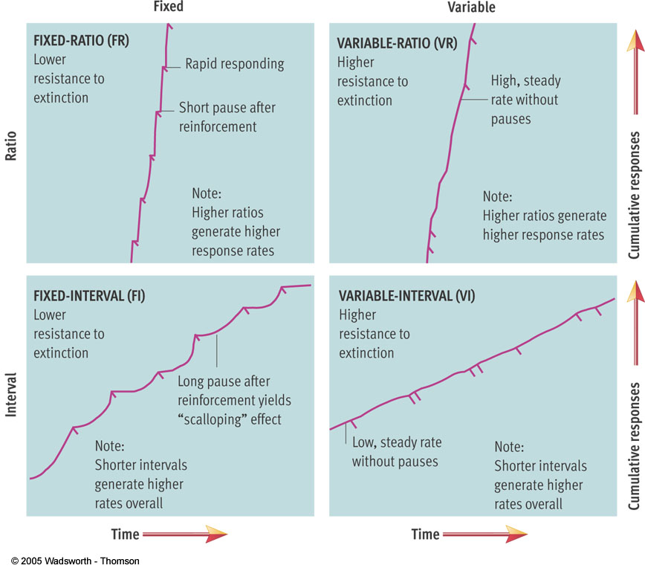
Reinforcement Schedules

Slide 34

Punishment
Any action that leads to a decrease in behavior
Types
  Positive Punishment – Adding an undesired outcome (e.g., fine, electric shock, etc.)
  Negative Punishment – Removal of something desirable (e.g., time out, grounding, etc.)

Slide 35
Avoiding punishment/ negative outcomes
Avoidance Learning – Avoiding a specific behavior to avoid the outcome
Too much punishment???
  Learned Helplessness – when an organism learns that no behavior will allow it to avoid a negative outcome
    Martin Seligman’s study w/ dogs

Slide 36
Reinforcements vs. Punishments
Adding
Consequence
Removing
Consequence
Positive Reinforcement | Negative Reinforcement
Positive Punishment | Negative Punishment
Increasing
Behavior
Decreasing
Behavior

Slide 37
Positive Examples
Positive Reinforcement: Something is presented that encourages a behavior
  E.g., Getting money for an A, a gold star for acing a quiz, pleasant feelings after seeing someone
Positive Punishment: Something is presented that discourages a behavior
  E.g., Receiving a fine for breaking the law, physical punishment (e.g., spanking)

Slide 38
Negative Examples
Negative Reinforcement: Something is removed that encourages a behavior
  E.g., Feeling better after seeing a doctor, a friend brightens a bad mood
Negative Punishment: Something is removed that discourages a behavior
  E.g., Being grounded, losing financial aid after plagarism

Slide 39
Reinforcement/Punishment: Timing
The best reinforcements/punishments are those that are…
  Immediate
    The closer the reinforcement/punishment is to the behavior of interest, the more likely the subject is to associate it with the behavior
    Delayed reinforcement/punishment can work, but the subject must have the association

Slide 40
Reinforcement/Punishment: Size
The best reinforcements/punishments are those that are…
  Neither too large nor too small
    Too small and the reinforcement/punishment may not have an impact
    Too large and the reinforcement might remove the need to continue any additional positive behaviors
      E.g., receiving 10 million dollars for graduating from college vs. $1000
    A punishment that is too large might immediately lead to learned helplessness

Slide 41
Uses of Operant Conditioning
Token economies:
  One early study (Ayllon & Azrin, 1968) was conducted with female schizophrenic patients
  Every time they did something desirable (e.g., showering, cleaning), they were given a token
  Eventually these tokens could be cashed in for rewards (e.g., candy, etc.)

Slide 42
Token Economies
Also effective in:
  Increasing student participation (Boniecki & Moore, 2003)
  Improving compliance to a diet (Magram & Papadopoulou, 1977)
  Improving outcomes for schizophrenic patients in general (Dickerson, Tenhula, & Green-Paden, 2005)

Slide 43
Social Learning Theory (1)
Learning purely through reinforcements and punishments is tedious…
  Behavior must occur in order to be reinforced or punished, random at times

Slide 44
Social Learning Theory (2)
People also learn how to behave in their environment just by observing the behavior of others (Bandura, 1977)
  Observational Learning!
Modeling: behaving based on observation of others doing the same action

Slide 45
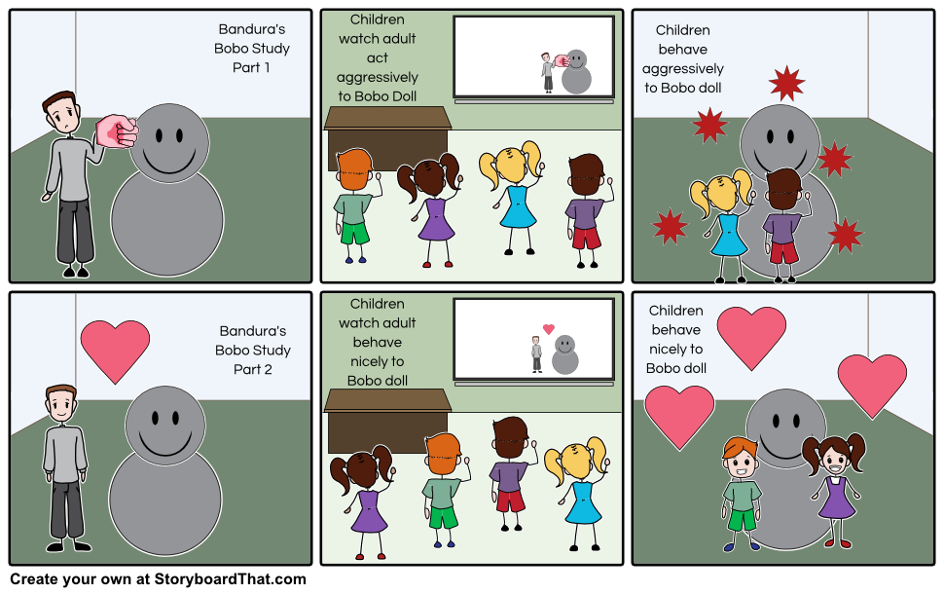
Bandura, Ross, & Ross (1961):
Bobo Doll Study

Slide 46
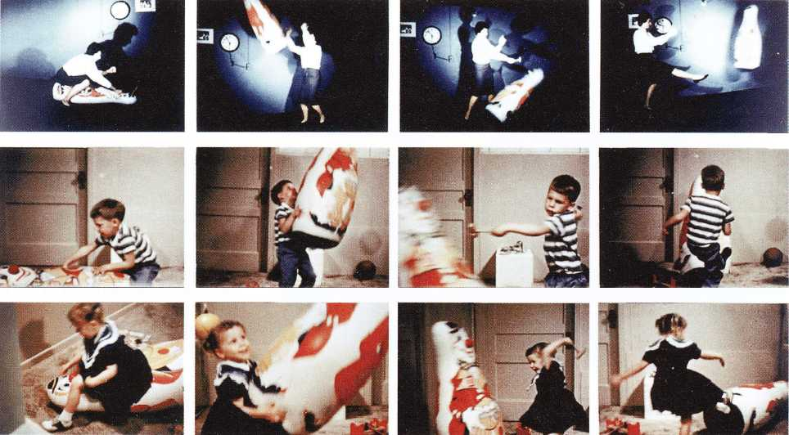
Social Learning Theory (1)
Social learning and violence:

Slide 47
Social Learning Theory (2)
Observational learning allows us to easily pick up knowledge from others
  E.g., going to a restaurant or coffee shop for the first time

Slide 48
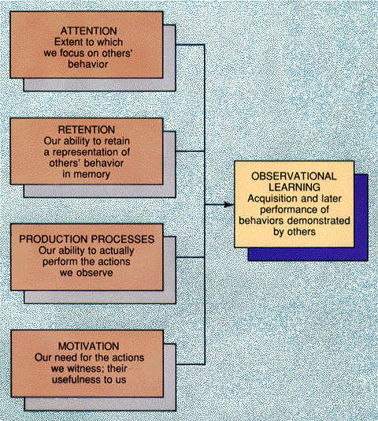
Bandura’s Model of Observational Learning
Motor Reproduction
Reinforcement
Can occur vicariously!

Slide 49
Social development theory (1)
While other theories of learning focus on the what the individual is doing, they largely ignore the situation
But learning is a combination of internal processes AND the constraints of social settings (Vygotsky, 1926)

Slide 50
Social development theory (2)
Understanding learning requires awareness of the social relationships that make learning possible
The process of learning is largely achieved by internalizing previously external skills and knowledge (Vygotsky, 1926)

Slide 51
Social development theory (3)
The internalization process can be conceptually split into three levels of skill:
  1) That which the person can do independently
  2) That which the person cannot do
  3) That which the person can do with help (the Zone of Proximal Development)

Slide 52
Frustration/Anxiety
Zone of Proximal Development
Boredom!

Slide 53
Cognitive Factors in Learning (1)
Skinner and other behaviorists argued that learning only occurred through observable events
  Cognition did not play a role in learning
  Pure Behaviorist Issues:
    Cannot account for spontaneous recovery
    Cannot account for observational learning unless vicarious reinforcement is in play
Cognitive (i.e., unobservable) mental processes may therefore also be at play in learning

Slide 54
Cognitive Factors in Learning (2)
E.C. Tolman (1932): Learning can be goal directed
  Behaviors can occur to accomplish steps to a larger goal in the absence of reinforcement
    E.g., studying to get a university degree

Slide 55
Cognitive Factors in Learning (3)
Latent learning
  Learning can occur even when reinforcement is not in play

Slide 56
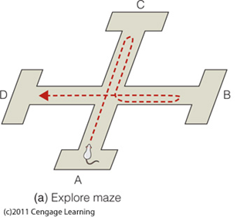
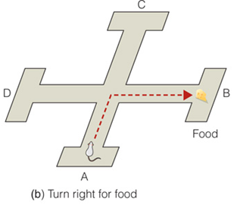
Tolman (1938) trained rats to find food in a four-armed maze (note: no smell)
He placed food at point “B”, the rats quickly learned to turn right to get the food

Slide 57
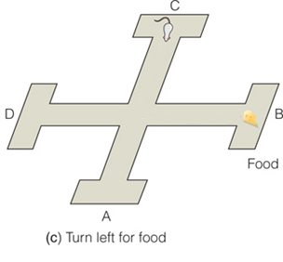
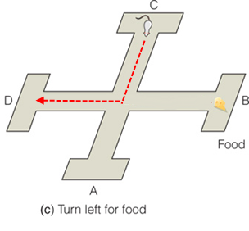
Tolman then placed the rat at point C (with the food still at point B)
A behaviorist would predict that the rat will go to D because it learned to associate “FOOD” with “TURNING RIGHT”

Slide 58
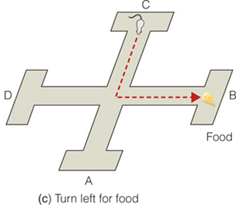
But instead the rats turned LEFT to the specific arm where they previously found food
Tolman proposed that the rats had created a cognitive map of the maze and were navigating to a specific arm
So something OTHER than stimulus-response determined the rat’s behavior
Cognitive map = internal representation = mind !!

Slide 59
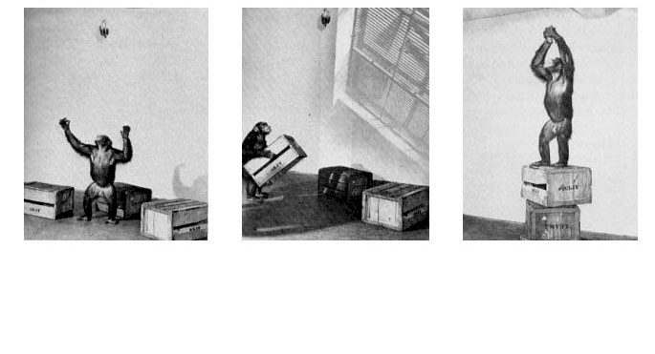
Cognitive Factors in Learning (4)
Insight Learning (Kohler, 1920)
  Subjects can learn to problem solve

Slide 60
Other Factors in Learning
Biological Constraints
  Instinctive drift (trained animals will sometimes revert to instinctual behavior)
Cultural/Environmental Influences
  Surfing vs. Snowboarding
Psychological Constraints
  Mindset: Fixed v. Growth
  Growth mindset increases rate of learning, learning potential, and reduces possibility of learned helplessness
  “Openness to new experiences”

Slide 61
Learning Controversy: Learning Styles
Learning Styles
  Visual, aural, kinesthetic
  Research suggests there is NO advantage to instruction within one’s preferred style (Rohrer & Pashler, 2012)
  Some evidence that there are different learning styles with regards to rule-based vs. memorization-based learning but differences are small (McDaniel et al., 2014)
    Rule-based learning – Using rules to learn information that needs to be remembered (e.g., how can information be organized based on relatedness?)
    Memorization-based learning – Using repetition to learn information

Slide 62
Reminder
Exam on Tuesday! (10/4)
Bring:
  Scantron
  Pencil
  Yourself!
Review guide will be posted this afternoon!

